Slide 1
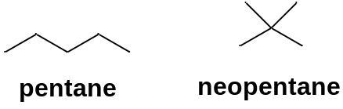
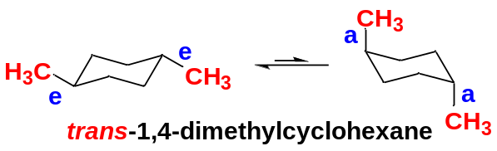
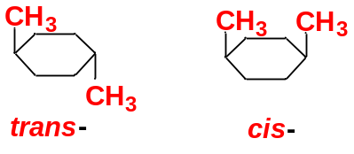
Chapter 3 Stereochemistry
1. Introduction
Stereochemistry is the study of the three-dimensional structure of molecules.
No one can understand organic chemistry, biochemistry, biology, and pharmacy without using stereochemistry.
Classification of Isomers: isomers are grouped into three broad classes:
Class | Name | Definition | Example
1 | Constitutional isomers | differ in bonding sequence, atoms connected differently.
2 | Conformational isomers | same compounds with different images in space.
3 | Stereoisomers | same bonding sequence, but they differ in the orientation of their atoms in space.
In this chapter, we study the three-dimensional structures of molecules to understand their stereochemical relationships.

Slide 2
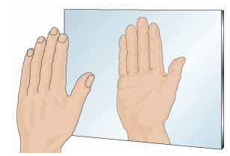
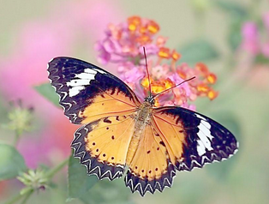
2. Chirality and Enantiomerism in organic molecules
2-1 Chiral and achiral objects
Our two hands are mirror images of each other. Though they look almost identical, they are nonsuperimposable (not identical).
Objects that have left-handed and right-handed forms are called chiral, the Greek word for “handed”
A chiral object has a mirror image that is different from the original object because they are not superimposable.
An object that is superimposable with its mirror image is called achiral, meaning “not chiral”.

Slide 3
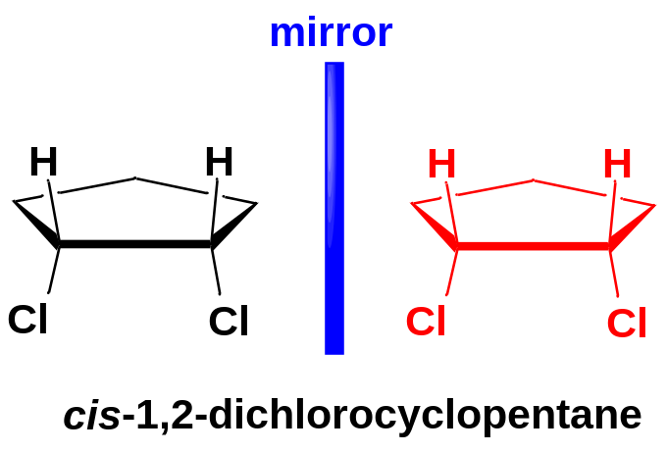
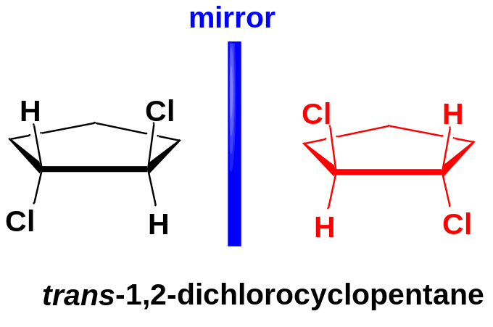
2-2 Chiral and achiral molecules
Like other objects, molecules are either chiral or achiral.
Consider the two cis,trans-isomers of 1,2-dichlorocyclopentane.
The original molecule and its mirror image are superimposable (identical, same compound)
Achiral molecule
same
The original molecule and its mirror image are nonsuperimposable (not identical, different compounds)
Chiral molecules
Enantiomers
Nonsuperimposable mirror-image molecules are called enantiomers.
A chiral compound always has a nonsuperimposable mirror image.
An achiral compound always has a mirror image that is the same as the original molecule.

Slide 4
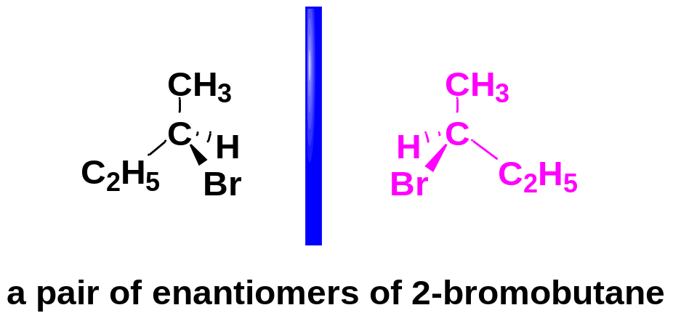
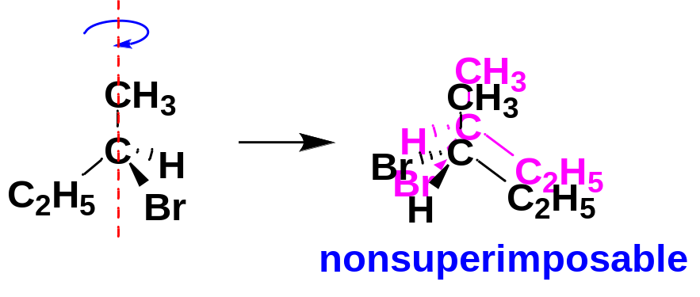
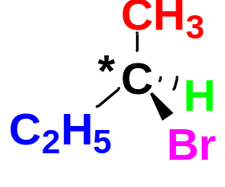
2-3 Asymmetric Carbon Atoms and Chirality Centers
2-bromobutane is chiral because it cannot be superimposed on its mirror image.
2-bromobutane has two distinct enantiomers.
The most common feature (but not the only one) that leads to chirality is a carbon atom that is bonded to four different groups.
Such a carbon is called an asymmetric carbon atom or a chiral carbon atom, and is often designated by an asterisk. An asymmetric carbon atom is the most common example of a chirality center.

Slide 5
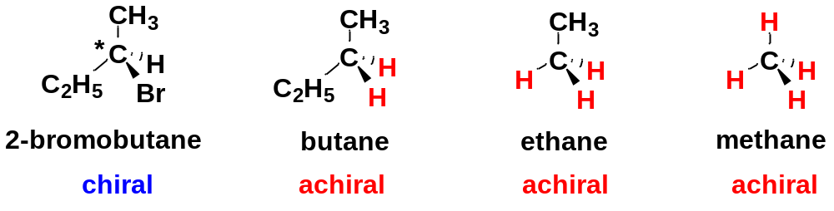
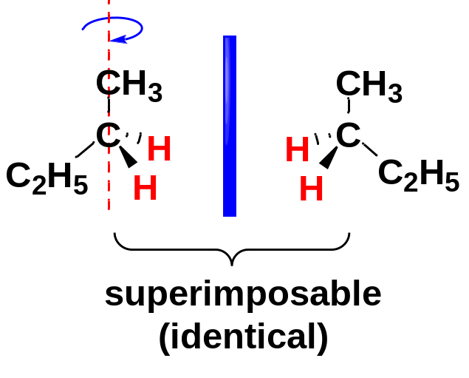
By contrast, If two (or more than two) of the four groups on a carbon atom are the same, the molecule usually is not chiral.
Keep in mind that the ultimate test for chirality is always whether the molecule’s mirror image is the same or different.

Slide 6
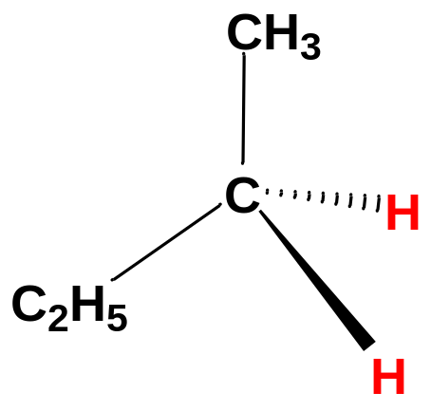
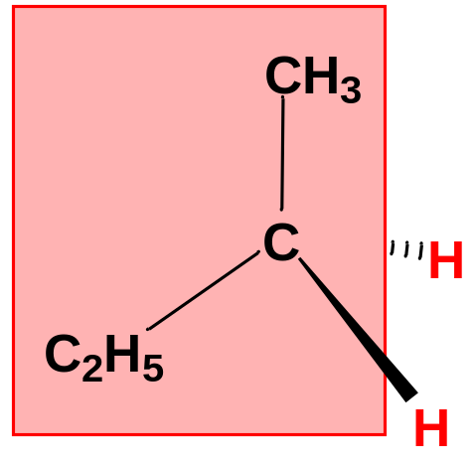
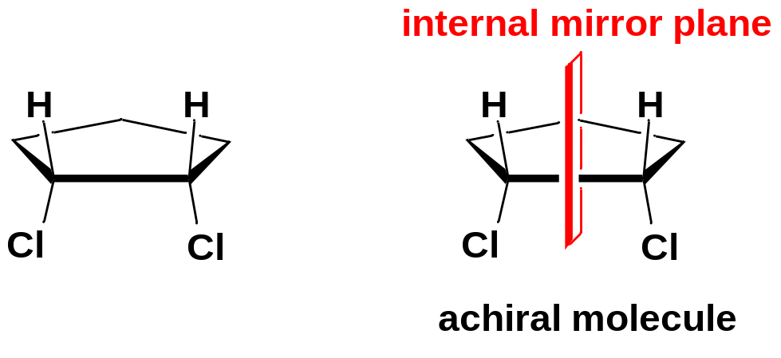
2-4 Mirror Planes of Symmetry
Though the ultimate test for chirality is always whether the molecule’s mirror image is the same or different, we have shortcuts to judge whether a molecule is chiral or achiral.
An internal mirror plane bisects the molecule into two parts and this two parts are also mirror images of each other.
Any molecule that has one or more internal mirror planes of symmetry is achiral.

Slide 7
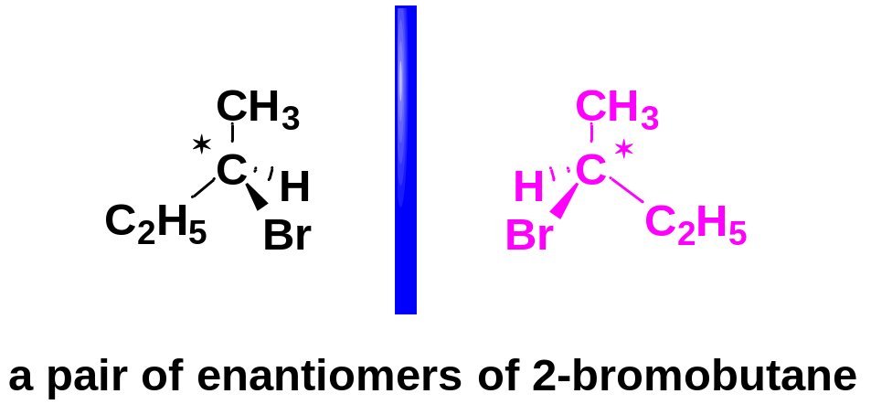
3 (R) and (S) Nomenclature of Asymmetric Carbon Atoms
3-1 the configurations of asymmetric carbons
Same constitution
Different configurations
The difference between the two enantiomers lies in the three-dimensional arrangement of the four groups around the asymmetric carbon atom.
Any asymmetric carbon has two possible (mirror-image) spatial arrangements, which we call configurations.
The Cahn-Ingold-Prelog convention (CIP) is widely accepted for naming the configurations of chirality centers. Each asymmetric carbon atom is assigned as (R) or (S) based on its three-dimensional configuration.

Slide 8
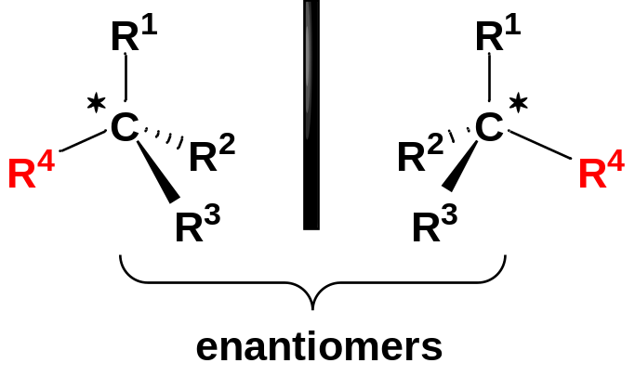
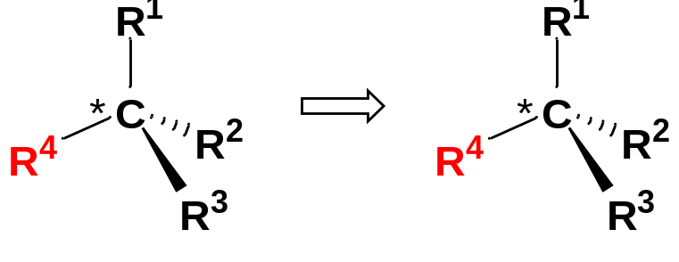
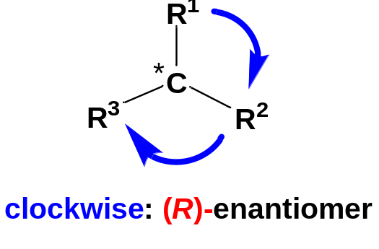

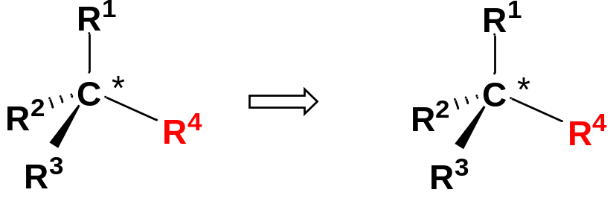
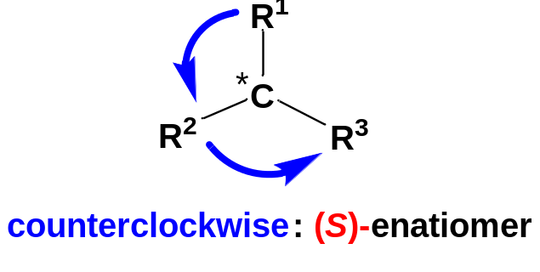

3-2 The 3-step Procedure
(1) Assign a “priority” to each group bonded to the asymmetric carbon.
(2) Using a three-dimensional drawing, put the fourth-priority group in back and view the molecule along the bond from the asymmetric carbon to the fourth-priority group.
(3) Draw an arrow from the first-priority group, through the second, to the third:
If the arrow points clockwise, the chiral carbon atom is called (R).
If the arrow points counterclockwise, the chiral carbon atom is called (S).

Slide 9
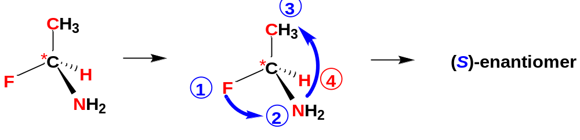
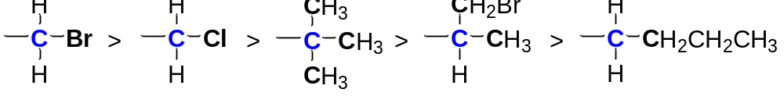
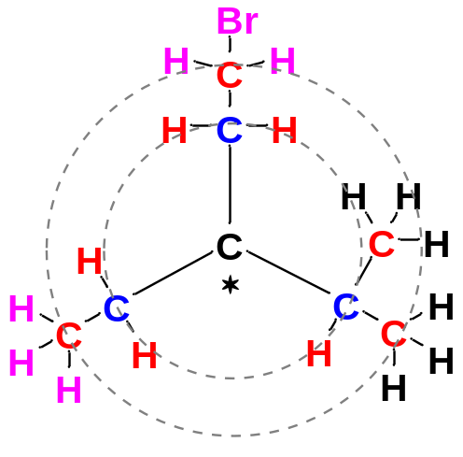
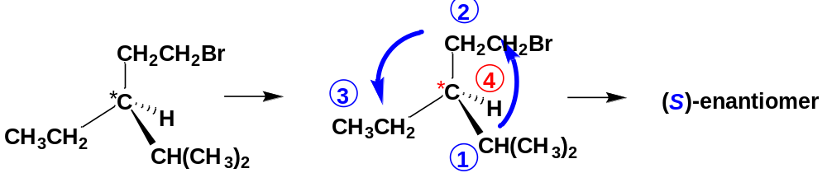
3-3 The CIP priority of groups
Look at the first atom of the group--the atom bonded to the asymmetric carbon.
Atoms with higher atomic numbers receive higher priorities.
I > Br > Cl > S > F > O > N > C > H
In case of ties, use the next atoms along the chain of each group as tiebreakers. One high-priority atom takes priority over any number of lower-priority atoms.

Slide 10
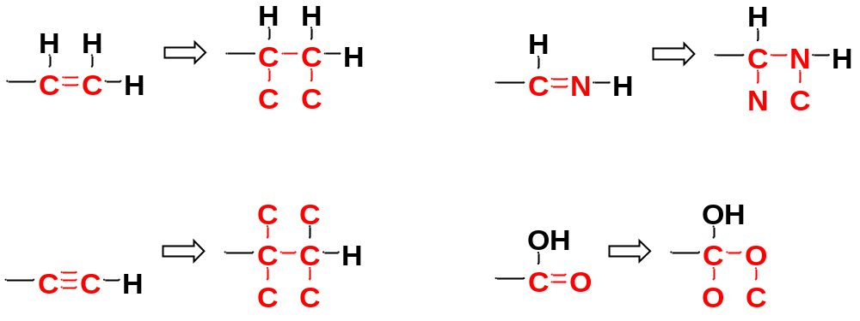
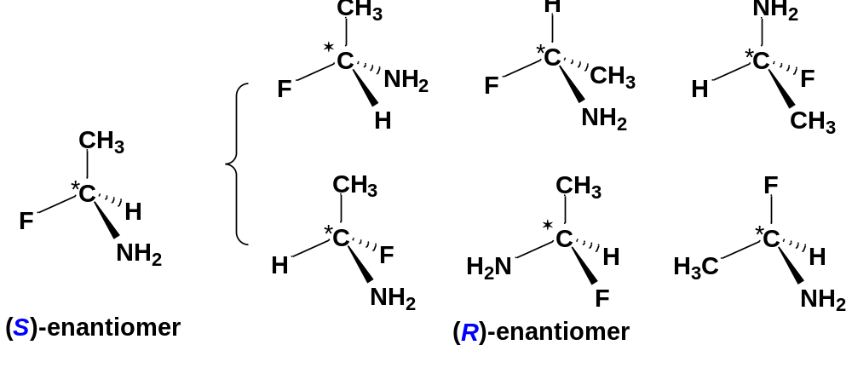
Treat double and triple bonds as if each were a bond to a separate atom. For this method, imagine that each pi bond is broken and the atoms at both ends duplicated. Note that when you break a bond, you always add two imaginary atoms.
Notice that interchanging any two groups on an asymmetric carbon atom inverts its configuration.

Slide 11
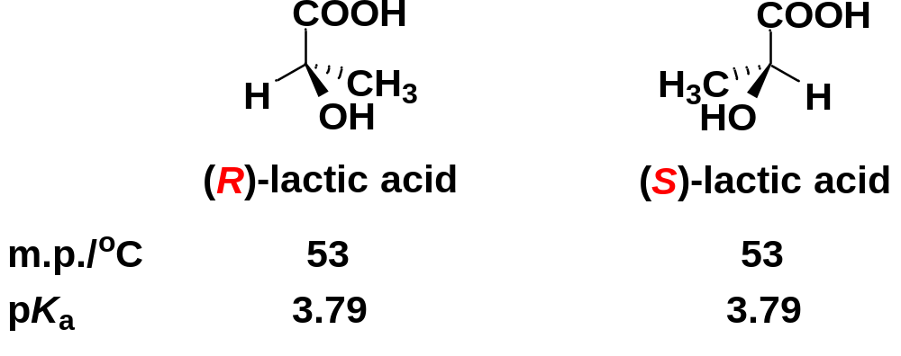
4. Physical Properties of Enantiomers
4-1 Identical Physical Properties
Enantiomers have many identical physical properties: boiling points, melting points, solubilities, densities, pK_{a}, etc.
Enantiomeric compounds rotate the plane of polarized light by exactly the same amount but in opposite directions.

Slide 12
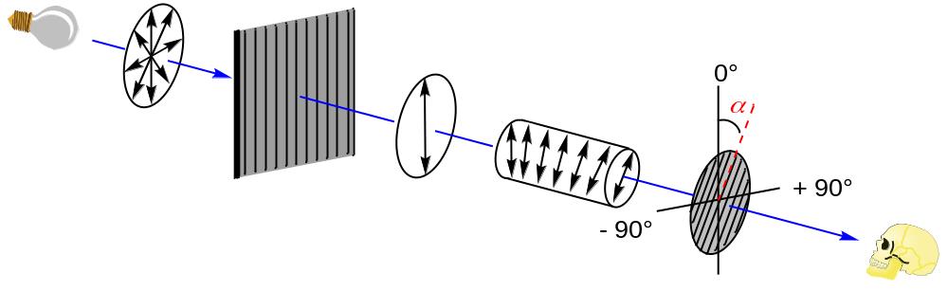
4-2 Optical Activity
4-2-1 Rotation of Plane-Polarized Light
Plane-Polarized Light is composed of waves that vibrate in only one plane.
sample cell containing a chiral molecule
waves vibrating in all directions
waves vibrating in a single plane
When plane-polarized light passes through a solution containing a chiral compound, the chiral compound causes the plane of vibration to rotate.
The observed rotation is symbolized by α.

Slide 13
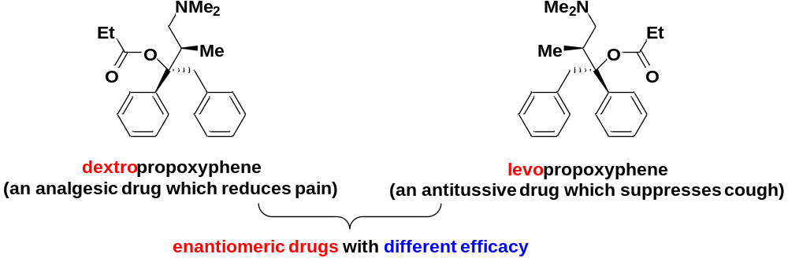
Rotation of the plane of polarized light is called optical activity. Substances that rotate the plane of polarized light are said to be optically active.
Compounds that rotate the plane of polarized light clockwise are called dextrorotatory (abbreviated by d), specified by the (+) sign.
Compounds that rotate the plane counterclockwise are called levorotatory (abbreviated by l), specified by the (-) sign.

Slide 14
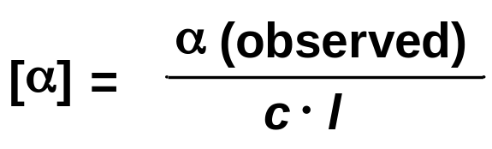
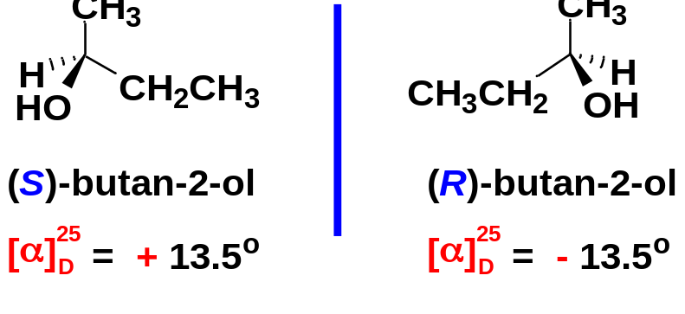
4-2-2 Specific Rotation
Different chiral compounds have different abilities to rotate the plane of polarized light. The rotation observed depends on the concentration of the sample solution and the length of the cell, as well as the optical activity of the chiral compound.
To use the rotation of polarized light as a characteristic property of a chiral compound, we must standardize the conditions for measurement.
We define a chiral compound’s specific rotation [α] as the rotation found using a 1 dm sample cell and a concentration of 1 g/mL. Other cell lengths and concentrations may be used, as long as the observed rotation is divided by the path length of the cell (l) and the mass concentration (c).
α (observed) = rotation observed
c = concentration in grams per mL
l = length of sample cell in decimeters
A rotation depends on the wavelength of light used and also on the temperature, so these data are given together with the rotation as [α]_{D}²⁵, where “25” means that the measurement was made at 25 °C, and the “D” means that the light used was the D line of the sodium spectrum.

Slide 15
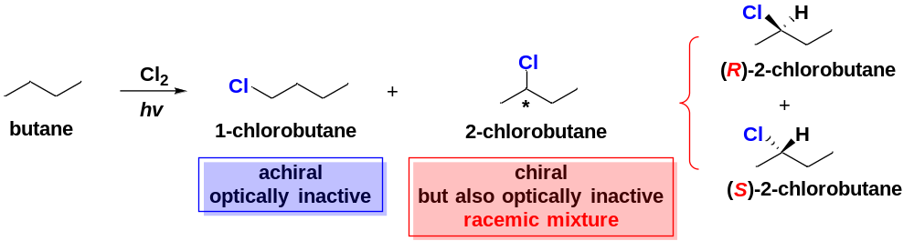
5. Racemic Mixtures
A mixture of equal amounts of two enantiomers is called a racemic mixture or a racemate, symbolized by placing (±) or (d,l) in front of the name of the compound.
A racemic mixture (racemate) is optically inactive, the rotation observed is zero, as though it were an achiral compound.
Many reactions lead to racemic products, especially when an achiral molecule is converted to a chiral molecule.
A reaction that uses optically inactive reactants and catalysts cannot produce a product that is optically active. Any chiral product must be formed as a racemic mixture.

Slide 16
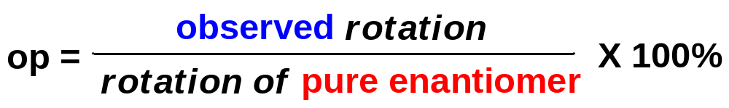
6. Enantiomeric Excess and Optical Purity
When we deal with mixtures that are neither optically pure (all one enantiomer) nor racemic (equal amounts of two enantiomers), we specify the optical purity (o.p.) of the mixture.
The optical purity (o.p.) of a mixture of unequal amounts of two enantiomers is defined as the ratio of its rotation to the rotation of a pure enantiomer.
It is known that the specific rotation of pure (+)-butan-2-ol is + 13.5°. If we have a sample as a mixture of (+)-butan-2-ol and (-)- butan-2-ol with a specific rotation of +9.72°.
The o.p. = (9.27 ÷ 13.5) × 100% = 72.0%
The enantiomeric excess (e.e.) is a similar method for expressing the relative amounts of enantiomers in a mixture.
To compute the enantiomeric excess of a mixture, we calculate the excess of the predominant enantiomer as a percentage of the entire mixture.

Slide 17
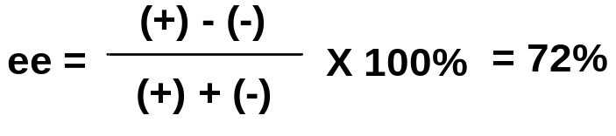
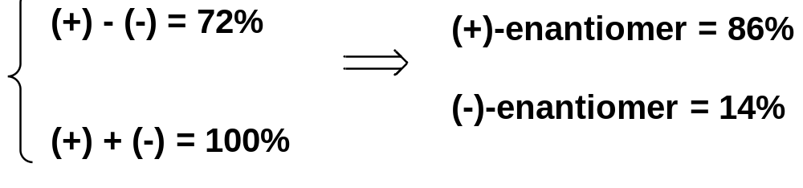
For a chemically pure compound, the calculation of enantiomeric excess generally gives the same result as the calculation of optical purity, and we often use the two terms interchangeably.
It is known that the rotation of the pure (+)-butan-2-ol is + 13.5°.
If we have a sample as a mixture of (+)-butan-2-ol and (-)- butan-2-ol with a specific rotation of + 9.72°. Calculate the percentages of (+)-enantiomer and the percentage of (−)-enantiomer of the sample.
The o.p. = (9.27° ÷ 13.5° ) X 100% = 72%.
Therefore the e.e of (+)-butan-2-ol = 72%, with the (+)-enantiomer in excess.

Slide 18
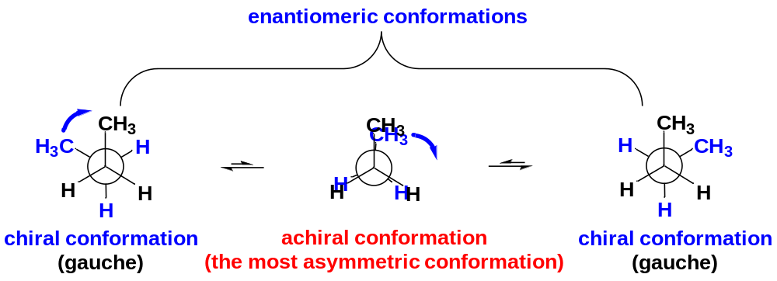
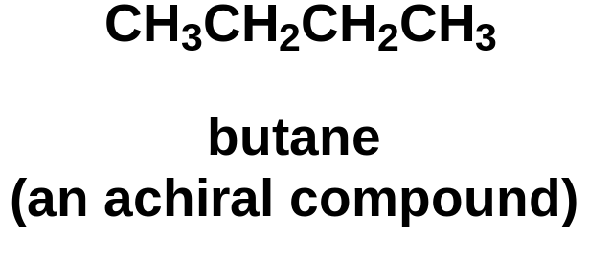
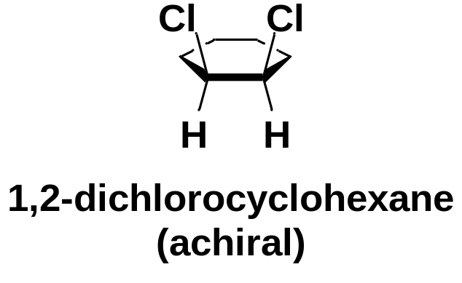
7. Chirality of Molecule and Chirality of Conformations
A molecule cannot be optically active if it its chiral conformations are in equilibrium with their mirror images. We consider such a molecule to be achiral.
To determine whether a conformationally mobile molecule can be optically active, consider its most symmetric conformation.
We can consider cycloalkane rings as though they were flat (the most symmetric conformation) when determining chirality.

Slide 19
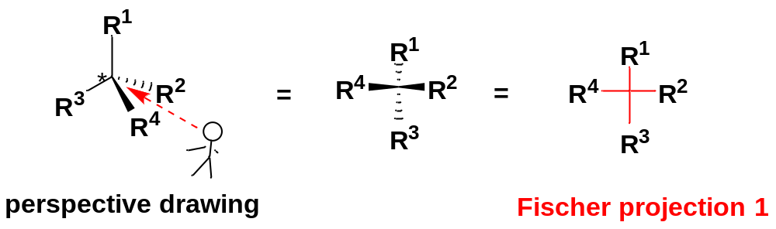
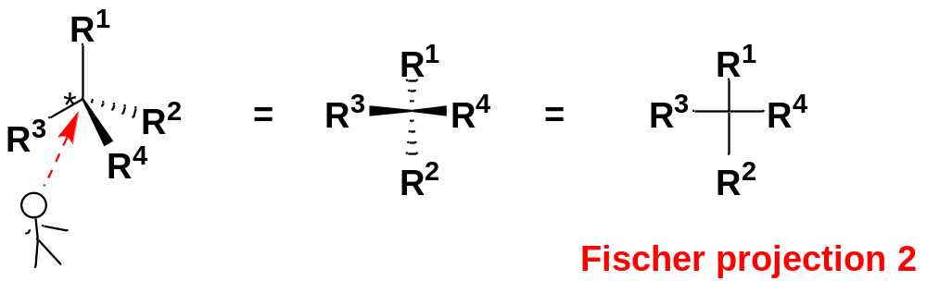
8. Fischer Projections
Sometimes, perspective drawings can be time-consuming and cumbersome in indicating the stereochemistry of chiral molecules.
Fischer Projections are a symbolic way of drawing asymmetric carbon atoms rapidly.
The Fischer projection looks like a cross, with the asymmetric carbon at the point where the lines cross.
The horizontal lines are taken to be wedges, namely bonds that project out toward the viewer.
The vertical lines are taken to be dashed lines, namely bonds that project away from the viewer.
“horizontal lines forward,
vertical lines back”

Slide 20
9. Diastereomers
Stereoisomers: isomers whose atoms are bonded together in the same order (the same bonding sequence) but differ in how the atoms are directed in space.
Enantiomers: mirror-image stereoisomers.
Diastereomers: all other stereoisomers that are not mirror images.
Most diastereomers are either cis, trans-isomers or compounds containing two or more chirality centers.
Enantiomers
mirror-image stereoisomers
Stereoisomers
Diastereomers
stereoisomers that are not mirror images

Slide 21
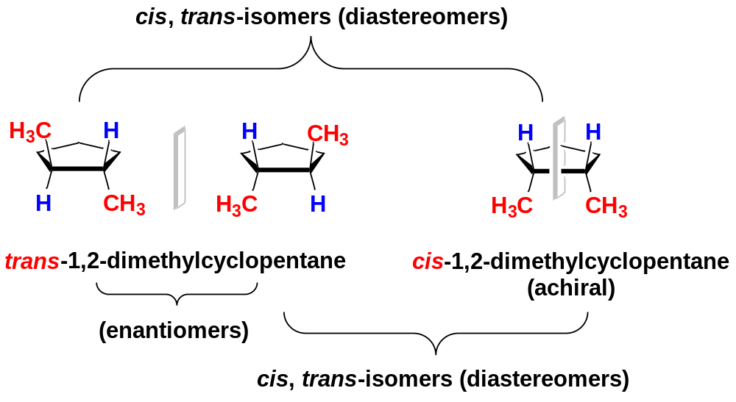
9-1 cis-trans Isomerism on Rings
Cis-trans isomerism is possible when there is a ring present.
Cis-trans isomers are diastereomers.

Slide 22
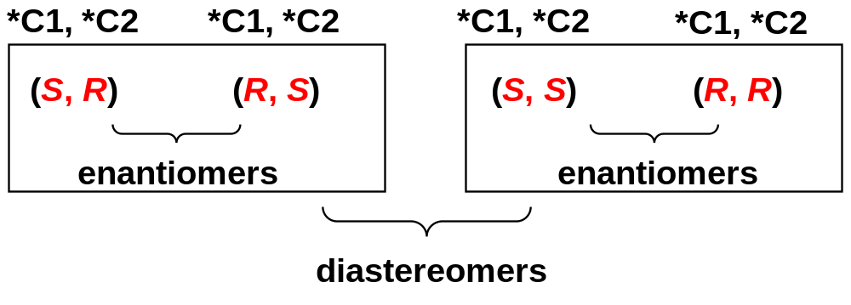
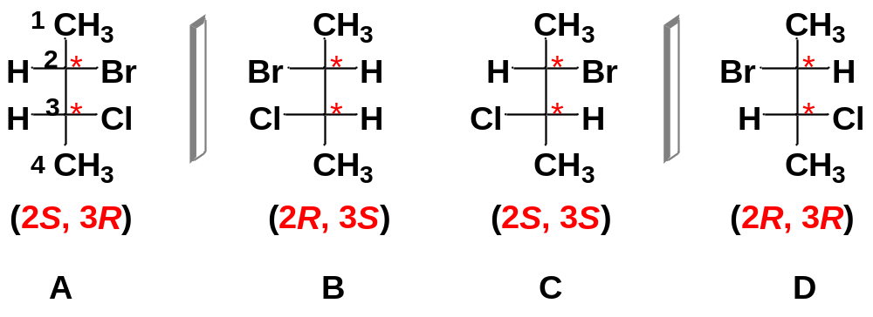
9-2 Diastereomers of Molecules with Two or More Asymmetric Carbons
A compound with 2 asymmetric carbon atoms can have 4 stereoisomers, as a result of all the permutations of (R) and (S) configurations at the two asymmetric carbon atoms.
Enantiomers | Diastereomers
A&B | A&C
C&D | A&D
 | B&C
 | B&D
Either member of one pair of enantiomers is a diastereomer of either member of the other pair.
2-bromo-3-chlorobutane

Slide 23
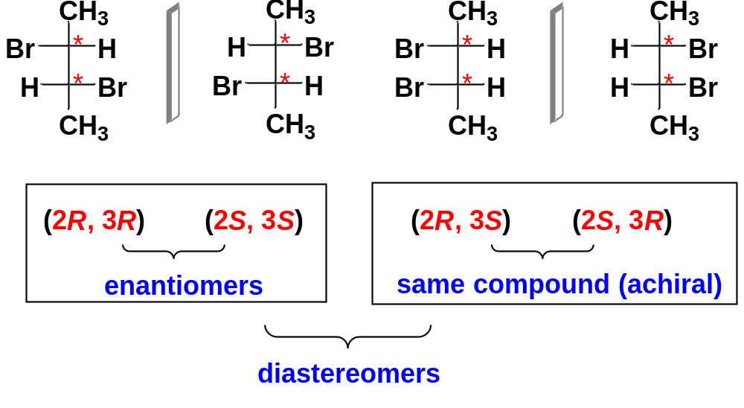
A compound with n asymmetric carbon atoms often has 2^{n} stereoisomers. This formula is called the 2^{n} rule. It suggests we should look for a maximum of 2^{n} stereoisomers.
However, we may not always find 2^{n} stereoisomers, especially when two of the asymmetric carbon atoms have identical substituents.
There are only 3 stereoisomers for molecules whose two asymmetric carbons have identical substituents.

Slide 24
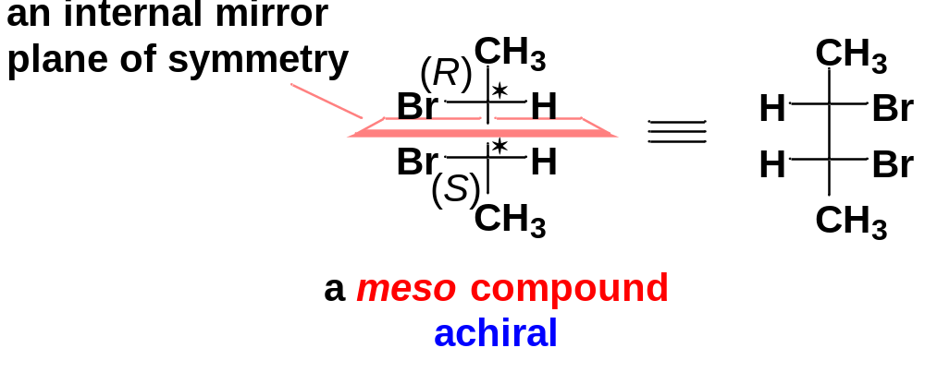
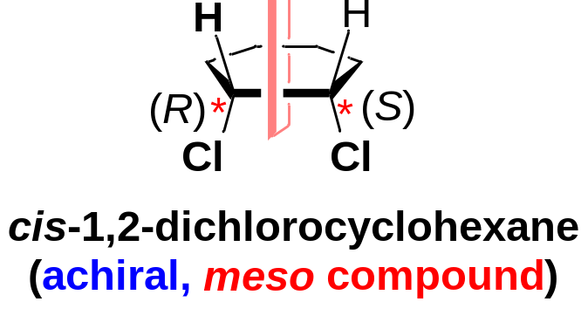
10. Meso Compounds
Compounds that are achiral even though they have asymmetric carbon atoms are called meso compounds.
Meso compound: An achiral compound that has chirality centers.
The (2R, 3S) isomer of 2,3-dibromobutane is a meso compound.
Most meso compounds have two similar halves of the molecule having opposite configurations.

Slide 25
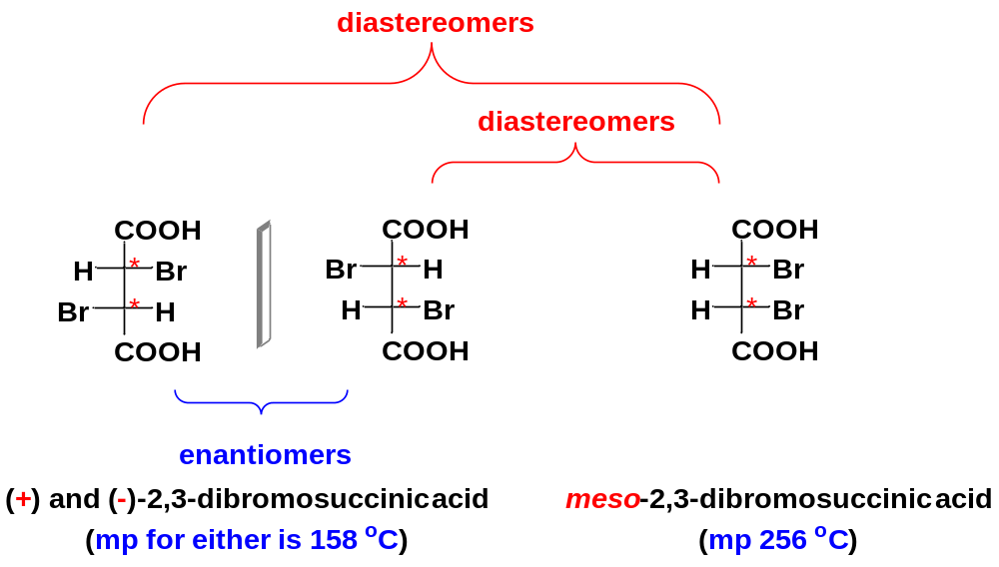
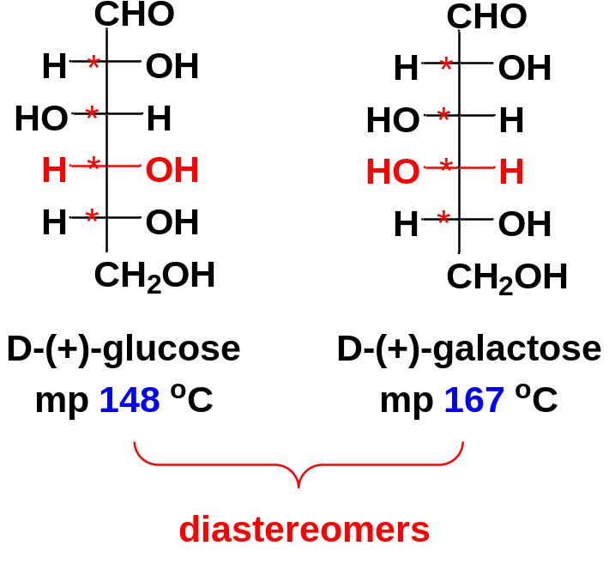
11. Physical Properties of Diastereomers
Enantiomers have identical physical properties except for the direction in which they rotate polarized light.
Diastereomers, on the other hand, generally have different physical properties.
Because diastereomers have different physical properties, we can separate diastereomers by ordinary means such as distillation, recrystallization, and chromatography.

Slide 26
12. Resolution of Enantiomers
Pure enantiomers of optically active compounds are often obtained by isolation from biological sources. Most optically active molecules are found as only one enantiomer in living organisms.
When a chiral compound is synthesized from achiral reagents, however, a racemic mixture of enantiomers is obtained. If we need one pure enantiomer, we must find a way of separating it from the other enantiomer.
The separation of enantiomers is called resolution. It is a different process from the usual physical separations.
An enantiomerically pure chiral compound is necessary for the resolution of enantiomers. Such a chiral compound is called a resolving agent.

Slide 27
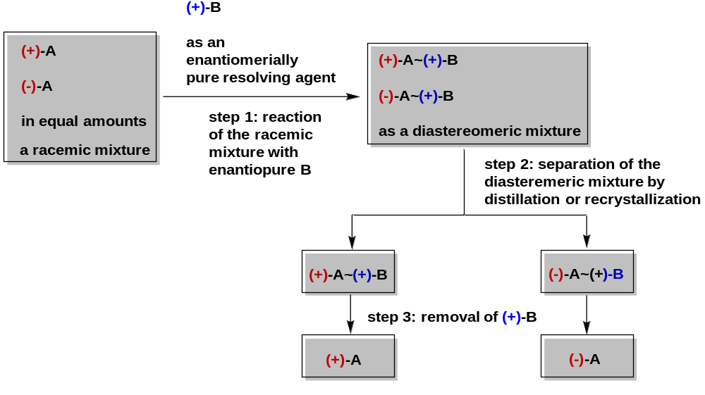
12-1 Chemical Resolution of Enantiomers

Slide 28

12-2 Chromatographic Resolution of Enantiomers
Enantiomers may be resolved by passing the racemic mixture through a column containing particles whose surface is coated with enantiomerically pure molecules.
As the solution passes through the column, the enantiomers form weak diastereomeric complexes with the chiral column packing.
These diastereomeric complexes have different physical properties. One of the two enantiomers will spend more time complexed with the chiral column packing. The more strongly complexed enantiomer passes through the column more slowly and emerges from the column after the faster-moving (more weakly complexed) enantiomer.

